Slide 1
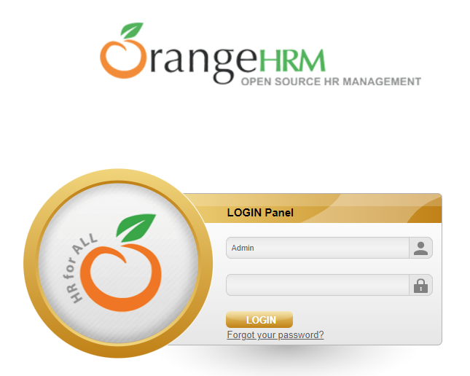
SMALL PROJECT 3 : API TESTING
Created by: Nurul Izzanni

Slide 2
TesT Case
Admin | Attendance | Employee
1. Create Token | 1. Punch In [ valid & invalid ] | 1. Save Employee
2. Get User | 2. Punch Out [ valid & invalid ] | 2. Employee Detail
3. User login ( valid & invalid ] |  | 3. Update Employee Detail
4. Get Organization Information |  | 4. Terminate Employment
 |  | 5. Employee Search
 |  | 6. Save Employee Contact Detail
 |  | 7. Employee Contact Detail
 |  | 8. Update Employee Contact
 |  | 9. Save Employee Dependent
 |  | 10. Delete Employee Dependent
 |  | 11. Save Employee Education
 |  | 12. Employee Education [ valid & invalid ]

Slide 3
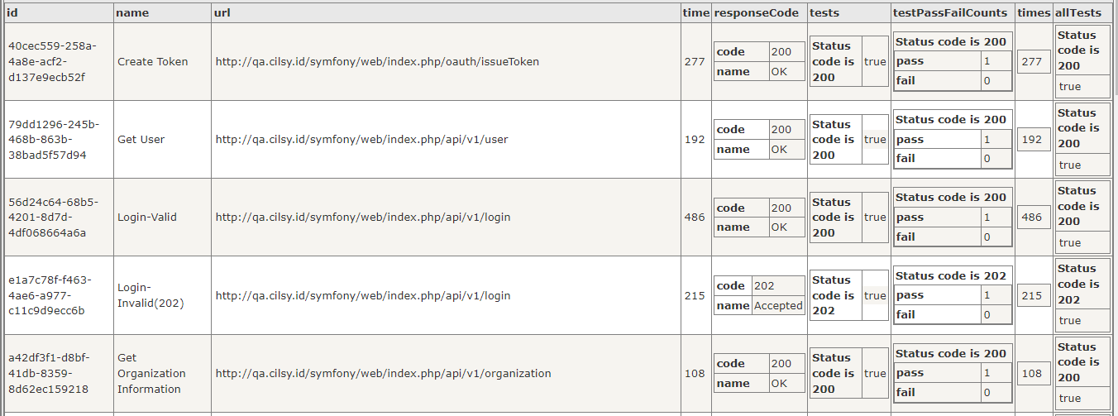
API RESULT - admin

Slide 4
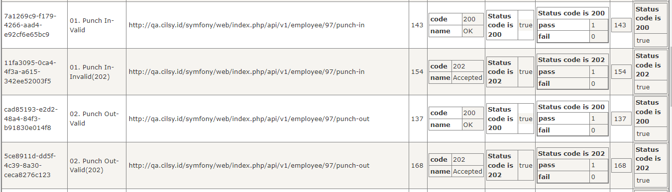
API RESULT - attendance

Slide 5
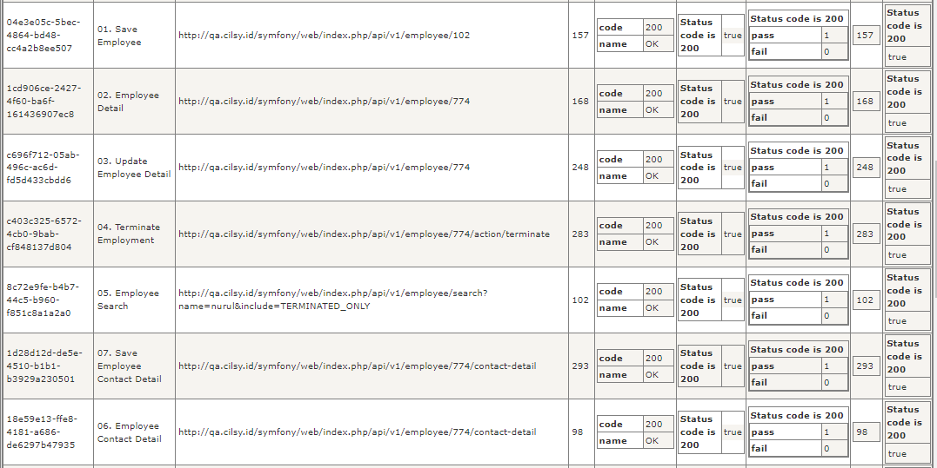
Api RESULT - EMPLOYEE

Slide 6
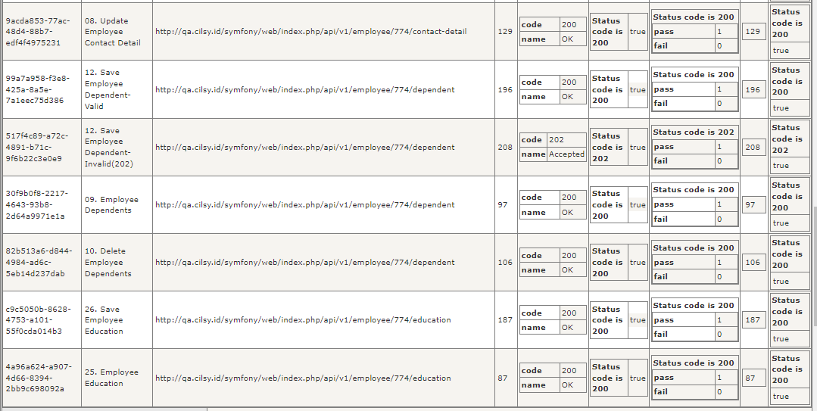
Api RESULT - EMPLOYEE

Slide 7

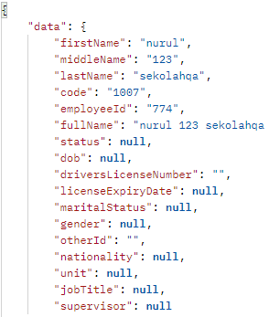
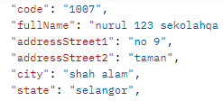
SQL ERROR
03. ( PUT ) Update Employee Detail
→ 02. ( GET ) Employee Detail
08. ( PUT ) Update Employee Contact Detail
→ 06. ( GET ) Employee Contact Detail

